Slide 1

Systems Analysis and Design in a Changing World, Fifth Edition

Slide 2
Learning Objectives
Explain the key role of a systems analyst in business
Describe the various types of systems an analyst might work on
Explain the importance of technical, people, and business skills for an analyst
Explain why ethical behaviour is crucial for a systems analyst’s career

Slide 3
Learning Objectives (continued)‏
Describe various job titles in the field and places of employment where analysis and design work is done
Discuss the analyst’s role in strategic planning for an organization
Describe the analyst’s role in a system development project

Slide 4
Overview
Information systems are
  Crucial to success of modern business organizations
  Constantly being developed to make business more competitive
  Impact productivity and profits
Keys to successful system development
  Thorough systems analysis and design
  Understanding what business requires

Slide 5
Overview (continued)‏
Systems analysis – process of understanding in detail what a system should accomplish
Systems design – process of specifying in detail how components of an information system should be physically implemented
Systems analyst – uses analysis and design techniques to solve business problems using information technology

Slide 6
The Analyst as a Business Problem Solver
Has computer technology knowledge and programming expertise
Understands business problems
Uses logical methods for solving problems
Has fundamental curiosity
Wants to make things better
Is more of a business problem solver than a technical programmer

Slide 7
Analyst’s Approach to Problem Solving
Research and understand the problem
Verify benefits of solving problem outweigh the costs
Define the requirements for solving the problem
Develop a set of possible solutions (alternatives)‏
Decide which solution is best and recommend
Define the details of the chosen solution
Implement the solution
Monitor to ensure desired results

Slide 8
Systems That Solve Business Problems
System:
a collection of interrelated components functioning together to achieve an outcome
Information systems – collection of interrelated components that collect, process, store, and provide as output the information needed to complete business tasks
Subsystem – part of a larger system
Functional decomposition – dividing a system into smaller subsystems and components

Slide 9
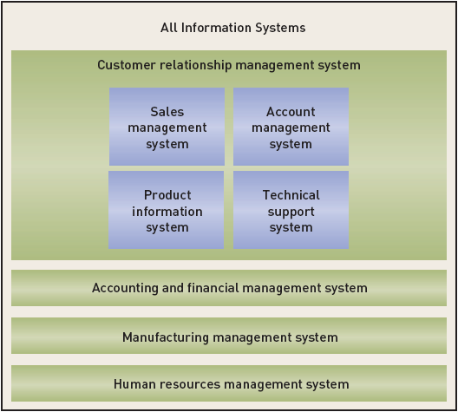
Information Systems and Subsystems

Slide 10
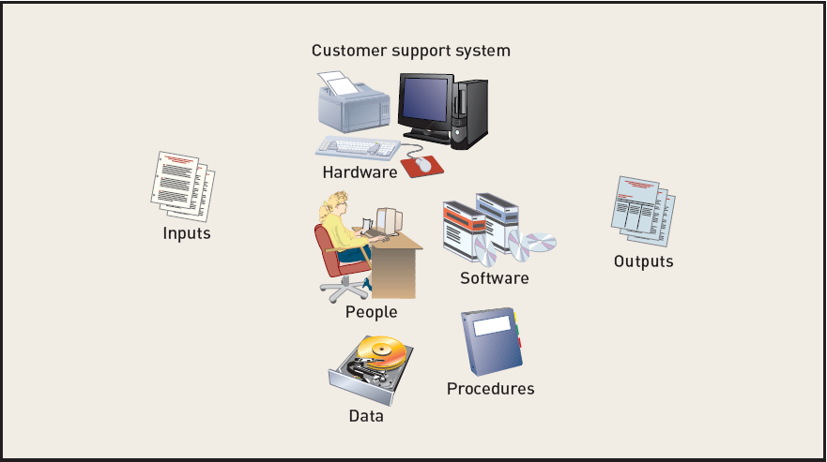
Information Systems and Component Parts

Slide 11
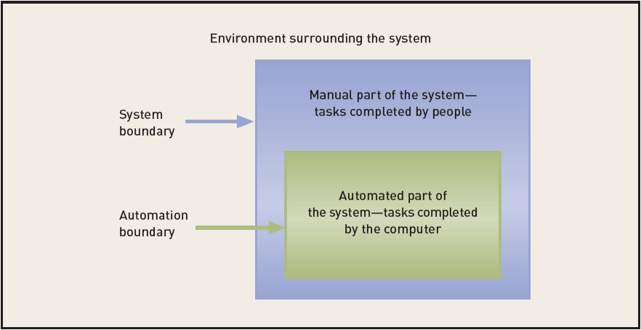
System Boundary vs. Automation Boundary

Slide 12
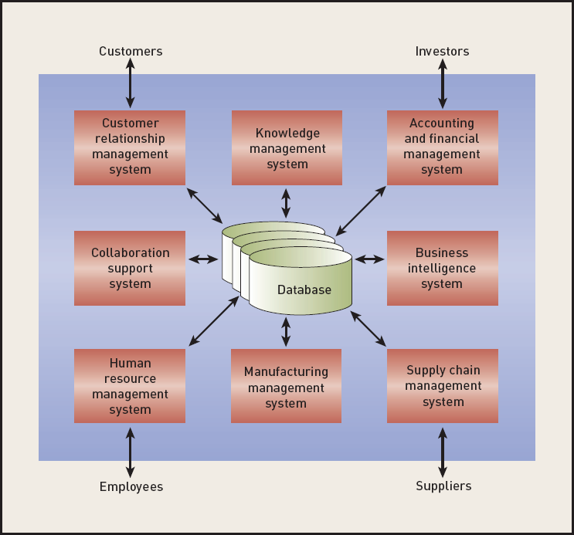
Types of Information Systems‏

Slide 13
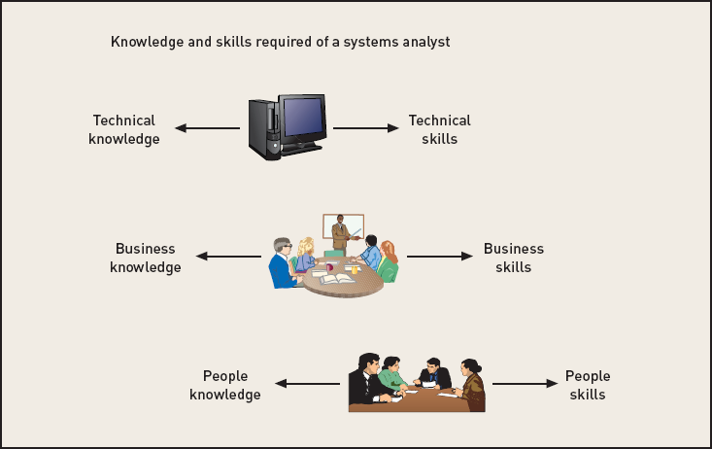
Required Skills of the Systems Analyst

Slide 14
Technical Knowledge and Skills
An analyst should have fundamental technology knowledge of
  Computers / peripheral devices (hardware)‏
  Files and database systems
  Input and output components and alternatives
  Computer networks and protocols
  Programming languages, operating systems, and utilities
  Communication and collaboration technology

Slide 15
Technical Knowledge and Skills (continued)‏
Analyst uses tools
  Software productivity packages
  Integrated development environments (IDEs) for programming languages
  Visual modeling tools and code generation tools
Analyst understands SDLC techniques
  Project planning, cost/benefit, interviewing
  Systems requirements modelling including
  Design, database design, network configuration

Slide 16
Business Knowledge and Skills
Analyst must understand
  Business functions performed by organization
  Strategies, plans, traditions, and values of the organization
  Organizational structure
  Organization management techniques
  Functional work processes
Systems analysts typically study business administration/management in college with a major in CIS or MIS

Slide 17
People Knowledge and Skills
Primarily a systems analyst must be an effective communicator
A systems analyst must be able to perform various roles such as negotiator, teacher, mentor, collaborator, and manager

Slide 18
Integrity and Ethics
Analyst has access to confidential information, such as salary, an organization’s planned projects, security systems, and so on.
  Must keep information private
  Any impropriety can ruin an analyst’s career
  An analyst plans the security in systems to protect confidential information

Slide 19
Systems Analyst Related Careers
Employment picture is complex with traditional programming jobs not as prevalent as previously
Many new opportunities exist in areas such as consulting, compliance, security, Web development, ERP support
Typical job titles include:
  Consultant – Business, Systems, Technical
  Analyst – Business systems, Systems support
  Developer – Web, systems
  Architect – Web, System, Software

Slide 20
The Analyst’s Role in Strategic Planning
Special projects affecting executives
  Business process management – redesign and improvements to existing processes
Strategic planning process
Information systems strategic planning
  Application architecture plan (business focus)‏
  Technology architecture plan (infrastructure focus)‏‏

Slide 21
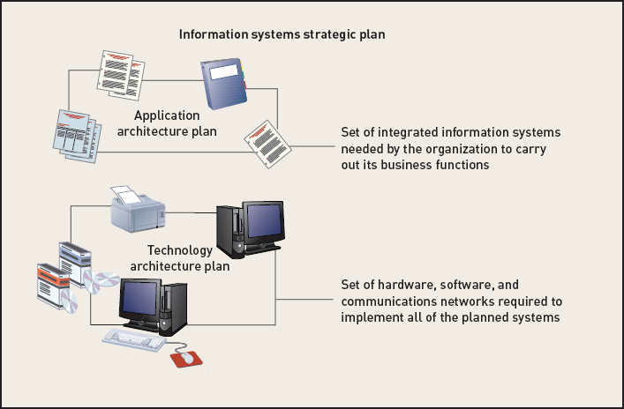
Components of an Information Systems Strategic Plan
Figure 1-7

Slide 22
Rocky Mountain Outfitters (RMO) and Its Strategic Information Systems Plan
RMO sports clothing manufacturer and distributor about to begin customer support system project
Need to understand the nature of the business, approach to strategic planning, and objectives for customer support system
RMO system development project used to demonstrate analysis and design concepts
Reliable Pharmaceutical Service (RPS) is a second case study for classroom purposes

Slide 23
Introduction to Rocky Mountain Outfitters (RMO) Business
Began in Park City, Utah supplying winter sports clothes to local ski shops
Expanded into direct mail-order sales with small catalog—as catalog interest increased, opened retail store in Park City
Became large, regional sports clothing distributor by early 2000s in Rocky Mountain and Western states
Currently $180 million in annual sales and 600 employees and two retail stores
Mail-order revenue is $90 million; phone-order revenue is $50 million

Slide 24

Early RMO Catalog Cover (Fall 1978)‏

Slide 25

Current RMO Catalog Cover (Fall 2007)‏

Slide 26
RMO Strategic Issues
Innovative clothing distributor; featured products on Web site ahead of competitors
Original Web site now underperforming
  Slow, poor coordination with in-house, poor supply chain management, poor technical support
Market analysis showed alarming trends
  Sales growth too slow, age of customers increasing, Web sales small percentage of total

Slide 27
RMO Strategic Issues (continued)
Enhanced Web site functions
  Add specific product information, weekly specials, and all product offerings
Detailed IS strategic plan
  Supply chain management
  Customer relationship management

Slide 28
RMO’s Organizational Structure
Managed by original owners
  John Blankens – President
  Liz Blankens – Vice president of merchandising and distribution
William McDougal – Vice president of marketing and sales
JoAnn White – Vice president of finance and systems
  Mac Preston – Chief Information Officer

Slide 29
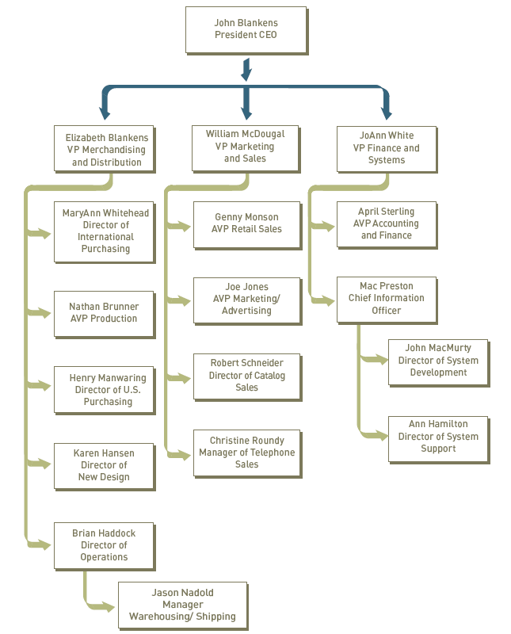
RMO Current Organization

Slide 30
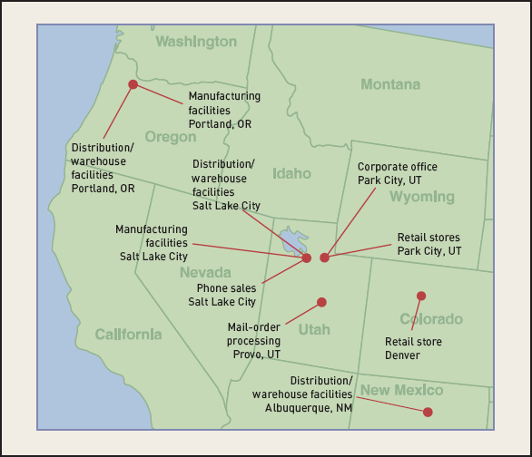
RMO Locations

Slide 31
RMO Information Systems Department
Mac Preston – Assistant vice-president and chief information officer (CIO)‏
  Recent promotion made after IS strategic plan created
  CIO reports to finance and systems VP
  CIO is increasingly important to future of RMO
  Given its strategic importance, IS department will eventual report directly to the CEO

Slide 32
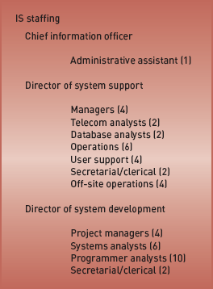
RMO Information Systems Department Staffing

Slide 33
Existing RMO Systems
Small server cluster system
  Supports inventory, mail-order, accounting, and human resources
  High capacity network connects distribution and mail-order sites
LANs and file servers
  Supports central office functions, distribution centers, and manufacturing centers

Slide 34
Existing RMO Systems (continued)‏
Supply Chain Management System
  Client/Server system in C++ and DB2‏
Mail Order System
  Mainframe COBOL/CICS(Customer Information Control System). Unable to handle phone orders
Phone order system
  Oracle and Visual Basic system built 6 years ago
Retail store systems
  Eight-year-old point-of-sale and batch inventory package, overnight update with mainframe

Slide 35
Existing RMO Systems (continued)‏
Office systems
  LAN with office software, Internet, e-mail
Human resources system
  Thirteen-year-old mainframe-based payroll and benefits
Accounting/finance system
  Mainframe package bought from leading vendor
Web Catalog and Order System
  Outside company until 2011. Irregular performance

Slide 36
The Information Systems Strategic Plan
Supports RMO strategic objectives
  Build more direct customer relationships
  Expand marketing beyond Western states
Plan calls for a series of information system development and integration projects over several years
Project launch: New customer support system to integrate phone orders, mail orders, and direct customer orders via Internet

Slide 37
RMO Technology Architecture Plan
Distribute business applications
  Across multiple locations and systems
  Reserve data center for Web server, database, and telecommunications
Strategic business processes via Internet
  Supply chain management (SCM)‏
  Direct customer ordering via dynamic Web site
  Customer relationship management (CRM)‏
Web-based intranet for business functions

Slide 38
RMO Application Architecture Plan
Supply chain management (SCM)‏
  Product development, product acquisition, manufacturing, inventory management
Customer support system (CSS)‏
  Integrate order-processing and fulfillment system with SCM
  Support customer orders (mail, phone, Web)‏
Strategic information management system
  Extract and analyze SCM and CSS information for strategic and operational decision making and control

Slide 39
RMO Application Architecture Plan (continued)‏
Retail store system (RSS)‏
  Replace existing retail store system with system integrated with CSS (Customer Service & Support)
Accounting/finance system
  Purchase intranet application to maximize employee access to financial data for planning and control
Human resources (HR) system
  Purchase intranet application to maximize employee access to human resources forms, procedures, and benefits information

Slide 40
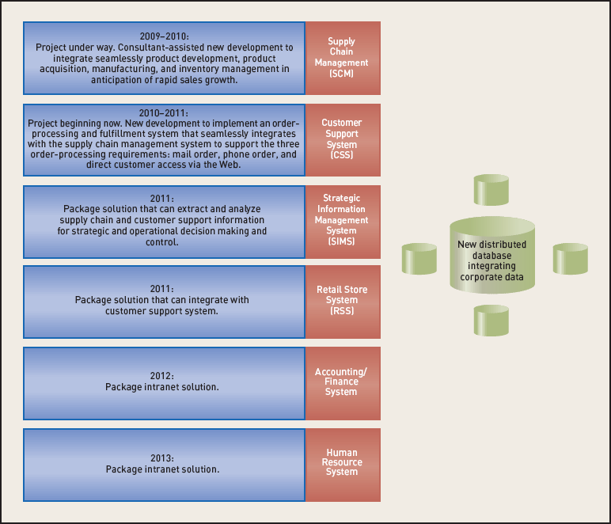
Timetable for RMO Strategic Plan

Slide 41
The Customer Support System (CSS)‏
RMO core competency is their ability to develop and maintain customer loyalty
CSS is a core system supporting complete customer relationship management
  Inquiries, order entry, order tracking, shipping, back ordering, returns, sales analysis
Systems analysis activities will define system requirements in detail
Strategic plan’s stated objectives will form guidelines as project proceeds

Slide 42
Analyst as a System Developer
Part 1: The systems analyst
  Chapter 1: The world of the information systems analyst (this chapter)‏
  Chapter 2: Approaches to system development
    Predictive and adaptive SDLCs
    Traditional approach
    Object-oriented approach
  Chapter 3: The analyst as a project manager

Slide 43
Analyst as a System Developer (continued)‏
Part 2: Systems analysis tasks
  Chapter 4: Beginning the analysis: Investigating system requirements
  Chapter 5: Modeling system requirements
  Chapter 6: Traditional approach to requirements
  Chapter 7: Object-oriented approach to requirements
  Chapter 8: Evaluating alternatives for requirements, environment, and implementation

Slide 44
Analyst as a System Developer (continued)‏
Part 3: Systems design tasks
  Chapter 9: Moving to design
  Chapter 10: Traditional approach to design
  Chapter 11: Object-oriented design: Principles
  Chapter 12: Object-oriented design: Use Case Realizations
  Chapter 13: Designing databases

Slide 45
Analyst as a System Developer (continued)‏
  Chapter 14: Designing the user interface
  Chapter 15: Designing system interfaces, controls, and security
Part 4: Implementation and support
  Chapter 16: Making the system operational
  Chapter 17: Current trends in system development
Supplemental Online Chapters
  Online Chapter 1: Software packages and ERP

Slide 46
Analyst as a System Developer (continued)
Online Appendices:
  Project management, finance, planning, interviewing
  Project schedules with PERT/CPM charts
  Calculating net present value, payback period, and return on investment
  Presenting the results to management

Slide 47
Summary
A systems analyst solves business problems using information systems technology
Problem solving means looking into business problem in great detail, completely understanding problem, and choosing best solution
Information system development is much more than writing programs

Slide 48
Summary (continued)‏
System – collection of interrelated components that function together to achieve some outcome
Information systems outcome – solution to a business problem
Information systems, subsystems, and components interact with and include hardware, software, inputs, outputs, data, people, and procedures

Slide 49
Summary (continued)‏
Systems analyst has broad knowledge and variety of skills, including technical, business, and people
Integrity and ethical behavior are crucial to success for the analyst
Systems analyst encounters a variety of rapidly changing technologies
Systems analyst works on strategic plans and then system development projects

